Slide 1
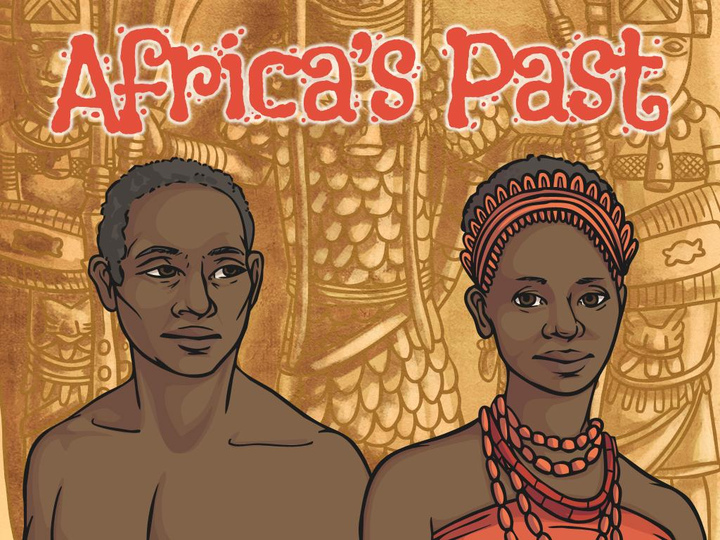


Slide 2
Aim
I can find out how the Kingdom of Benin developed.
Success Criteria
I can think and talk about my preconceptions of Africa and what I now know.
I can find and label important places in the history of the Kingdom of Benin on a map of Africa.
I can match key words about the Kingdom of Benin to the correct descriptions.
I can sort some events from the history of the Kingdom of Benin into chronological order.

Slide 3

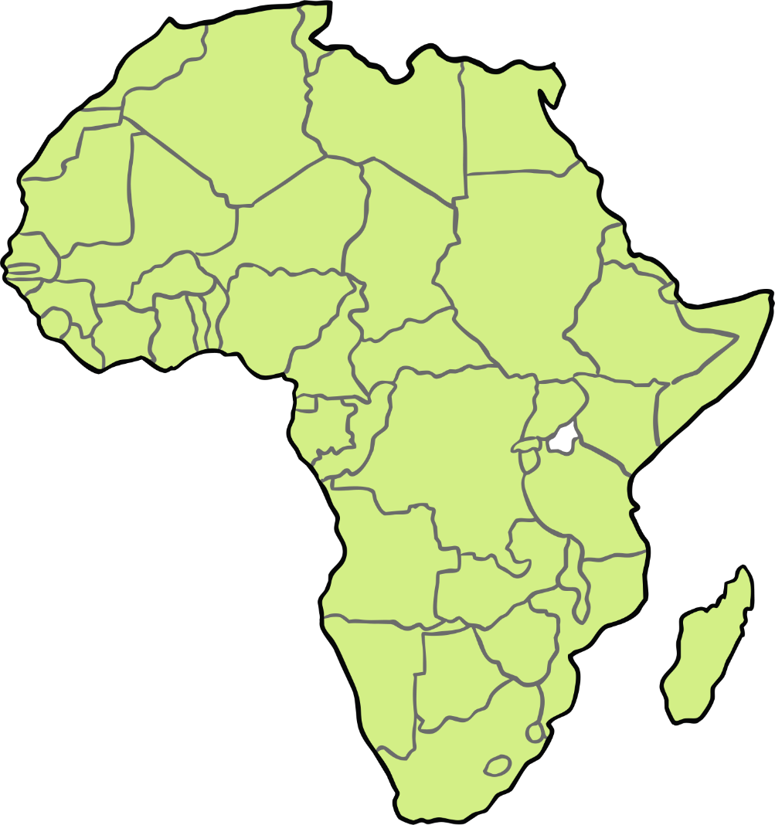
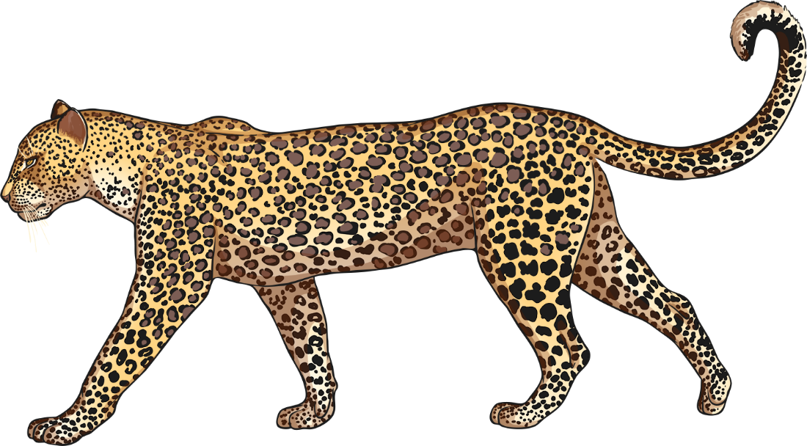
What Does Africa
Mean to You?
What word(s) come into your head when you think of Africa?
Write these words down on your sticky note and place it onto our large map of Africa.

Slide 4
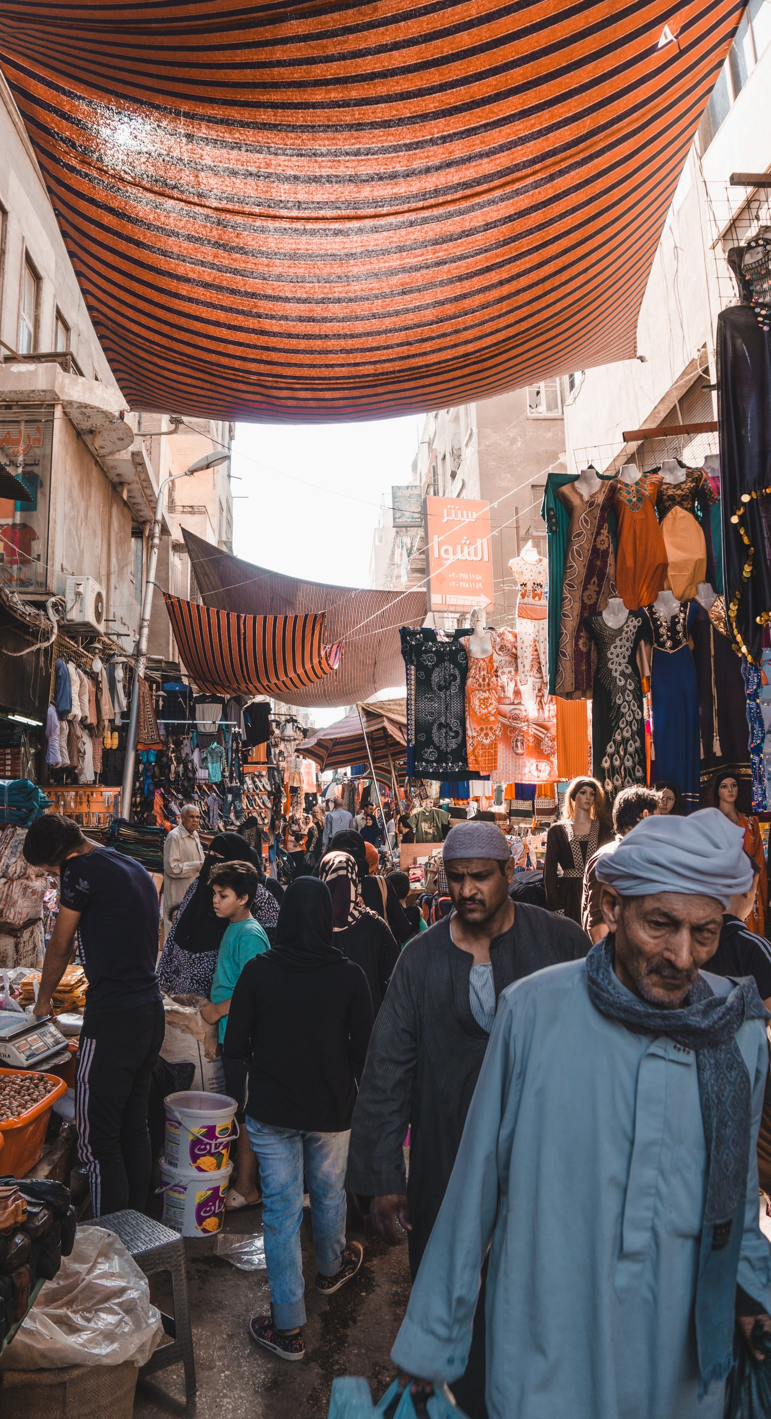
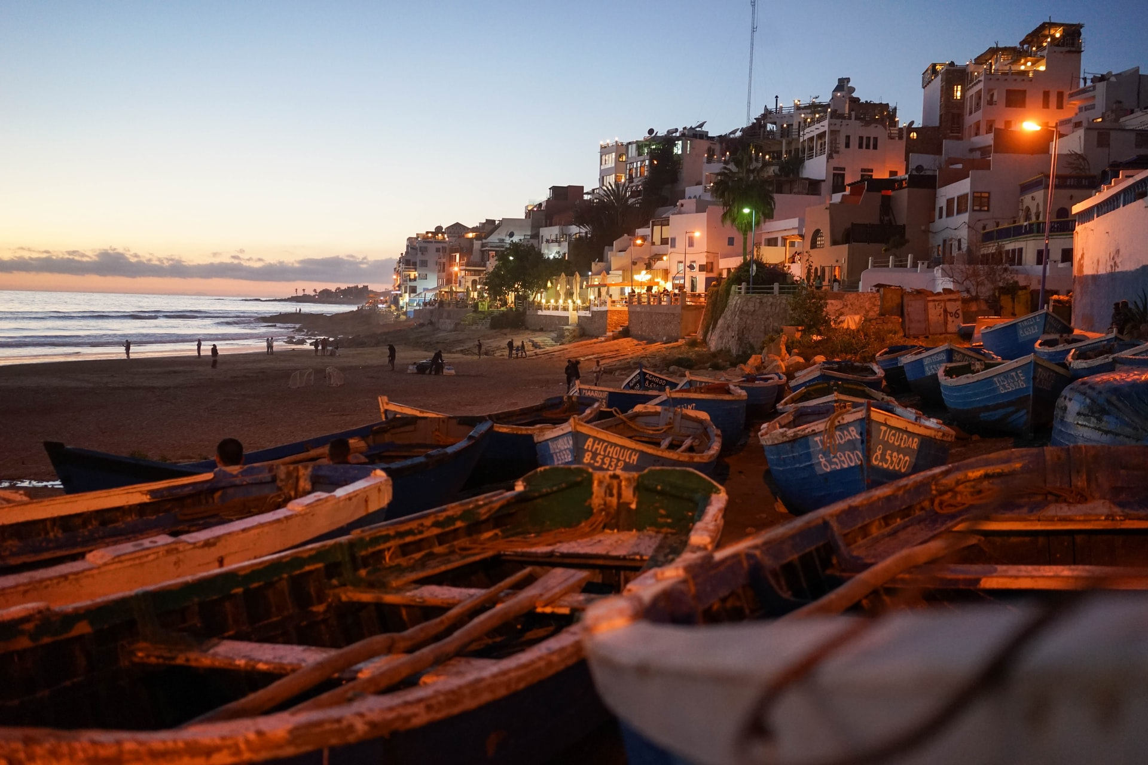
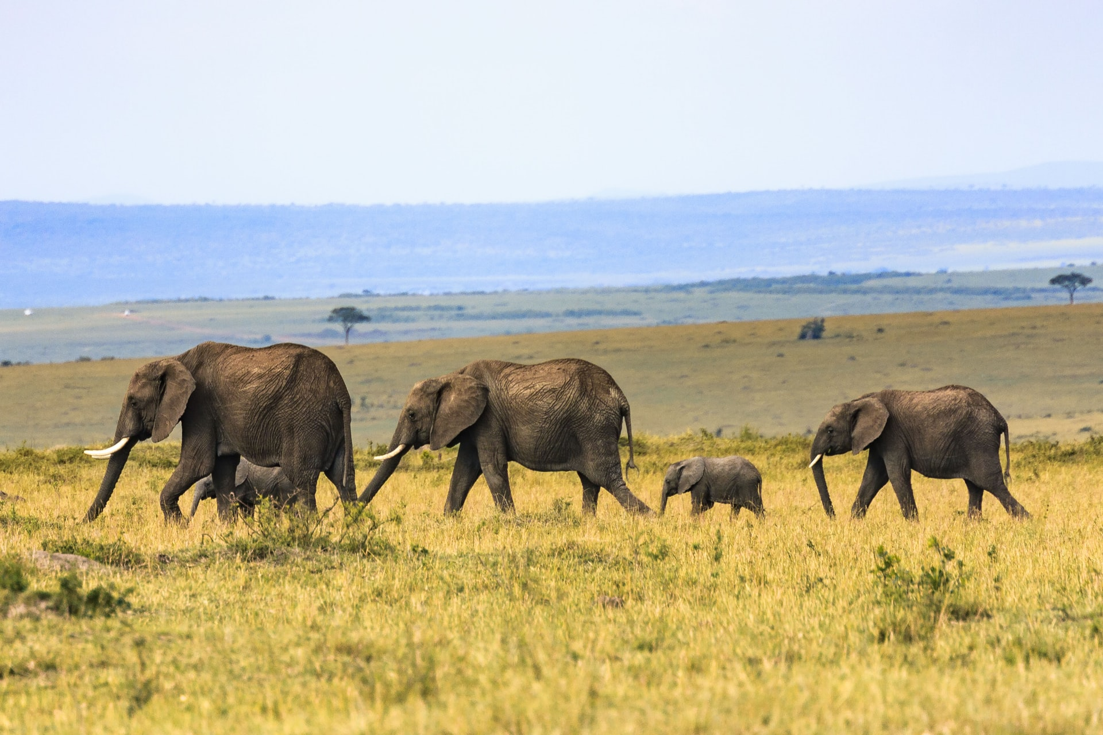


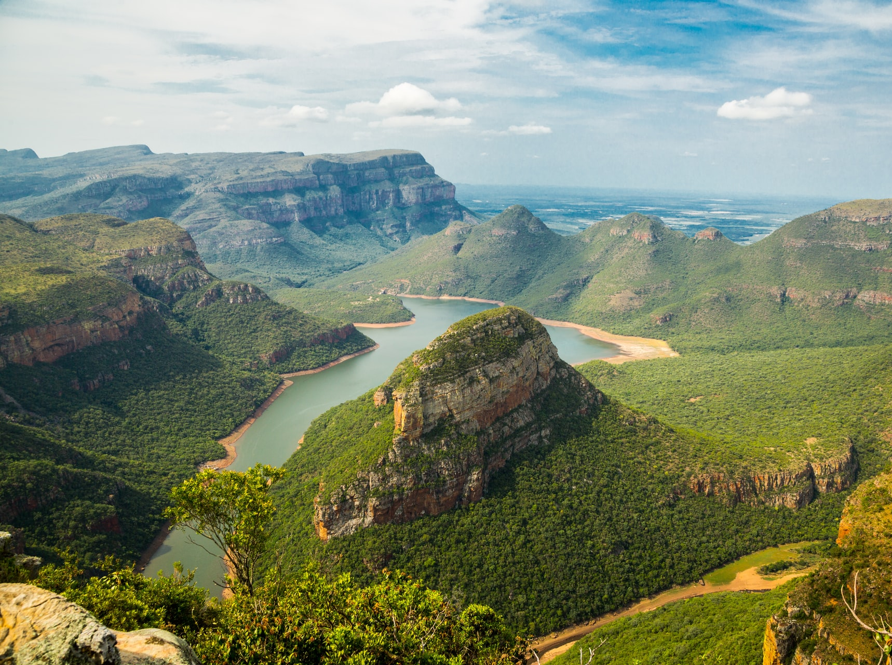
What Does Africa Mean to You?
Images of Africa
What questions do you have about these images?
Do any of them surprise you?

Slide 5
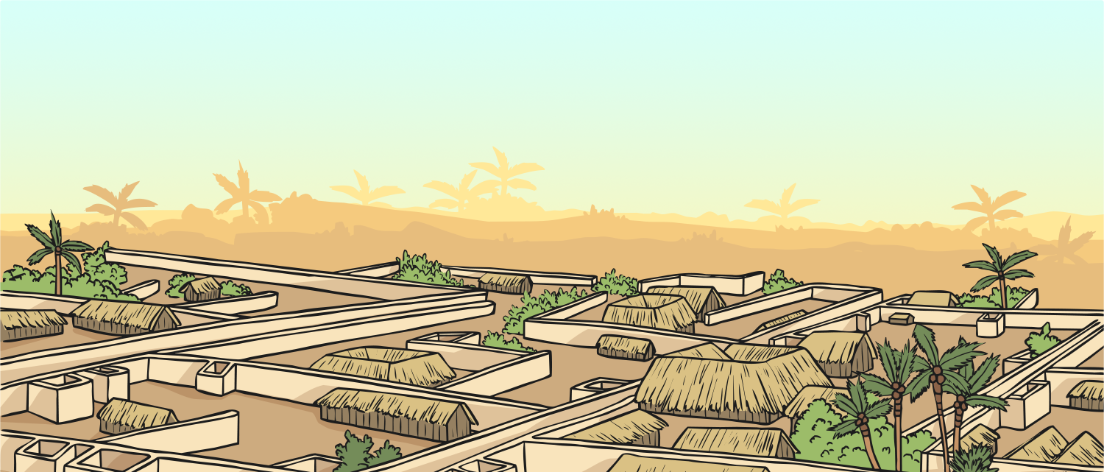
What Does Africa
Mean to You?
Africa is a huge continent with a large variety of physical features, climates and countries. Just like Europe, which has a diverse range of countries and people that live there, it would be impossible to describe Africa in a few words.
Africa has an extremely interesting history – a part of which we shall learn about in this unit.

Slide 6

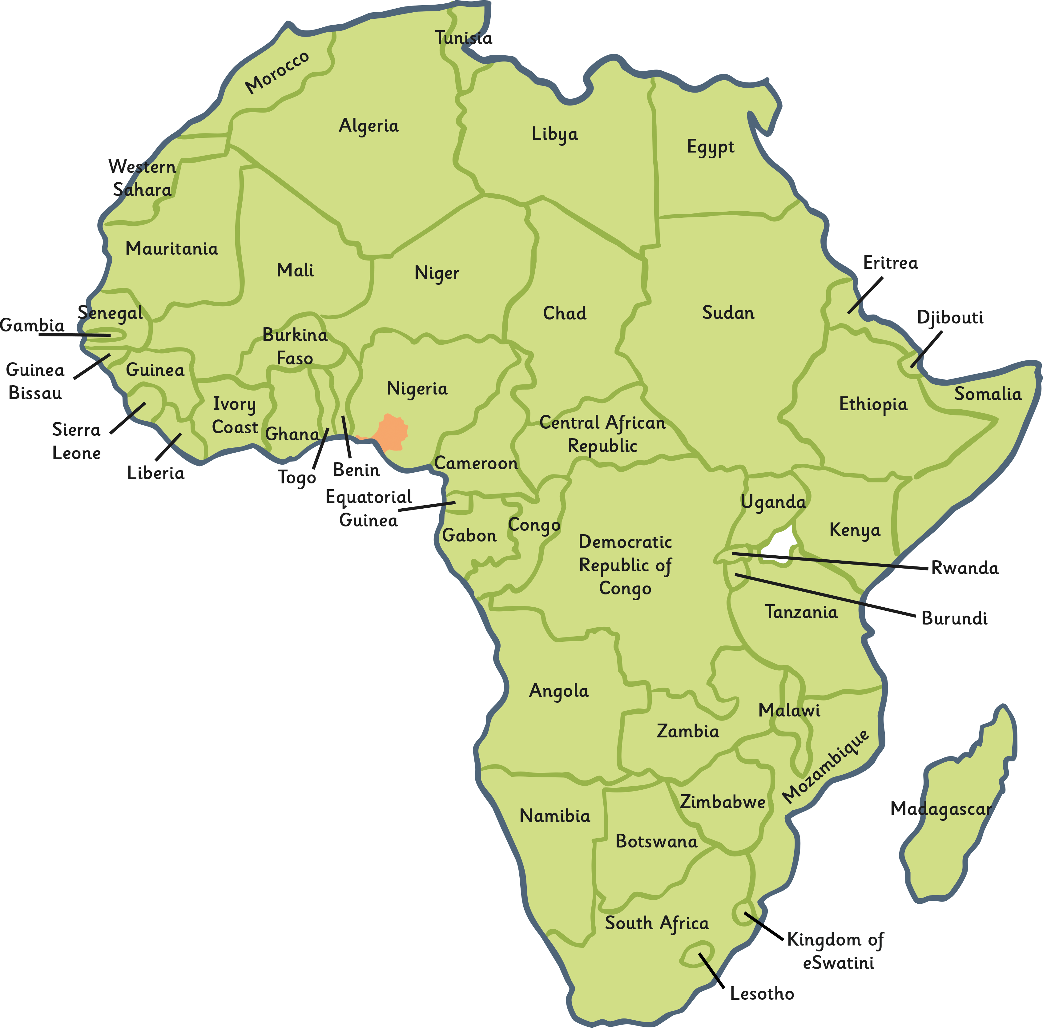
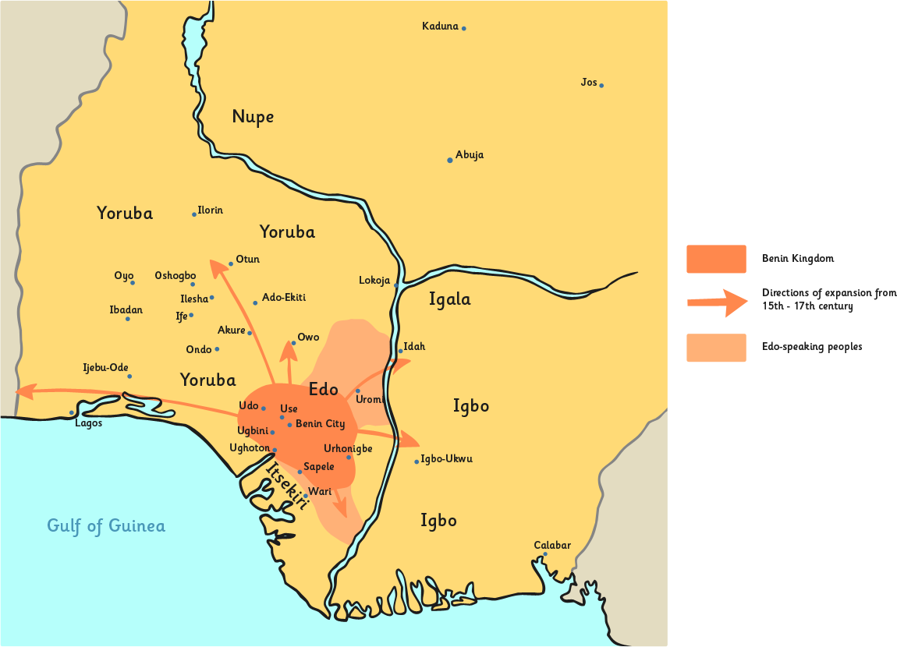
Mapping Africa
The ancient Kingdom of Benin was in what is now Nigeria. Modern Benin is a country next to Nigeria – don’t be confused between the two!
Located entirely within what is now Nigeria, the Kingdom of Benin stretched from Lagos in the west to beyond the River Niger in the east, an area that equates to about a fifth of modern-day Nigeria.

Slide 7
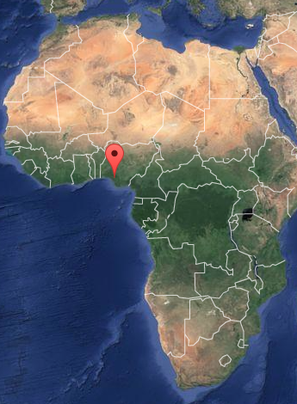
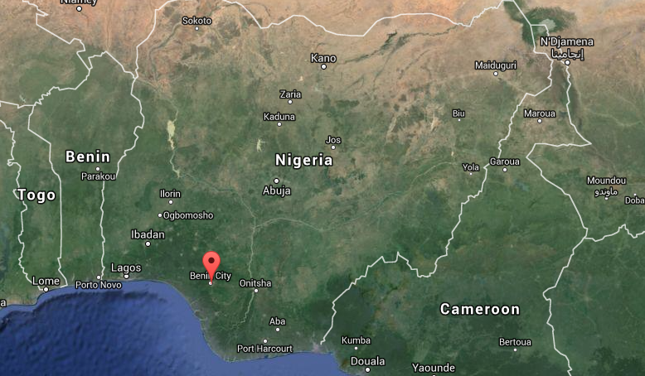
Mapping Africa
Take a look on Google Maps at Nigeria.
What does the terrain of Nigeria look like?
Locate Nigeria on your map of Africa.
Can you mark Benin City on your map?
Where is the town of Ife?
The city of Lagos?
Can you draw where the River Niger is?
Can you name any other countries in Africa?
Source: Map data, Google, 2015

Slide 8

How Did the Kingdom of
Benin Develop?
It was around AD 900 when the Kingdom of Benin started to develop. Boundaries were established around the region called Igodomigodo in what is now called Nigeria.
The original people and founders of the Kingdom of Benin were ruled by the Ogiso (meaning ‘Kings of the Sky’). The first Ogiso (who was called Igodo) became very popular as a good ruler.
Altogether it is thought that there were around 31 Ogiso rulers.

Slide 9
How Did the Kingdom of
Benin Develop?
Around AD 1100, the last Ogiso (called Owodo) died.
Owodo’s son had fled from Igodomigodo so there was nobody to rule.
A battle ensued about who should take control. Some people believe that the chiefs of Igodomigodo asked the Yoruba people of the nearby holy city of Ife for help.

Slide 10
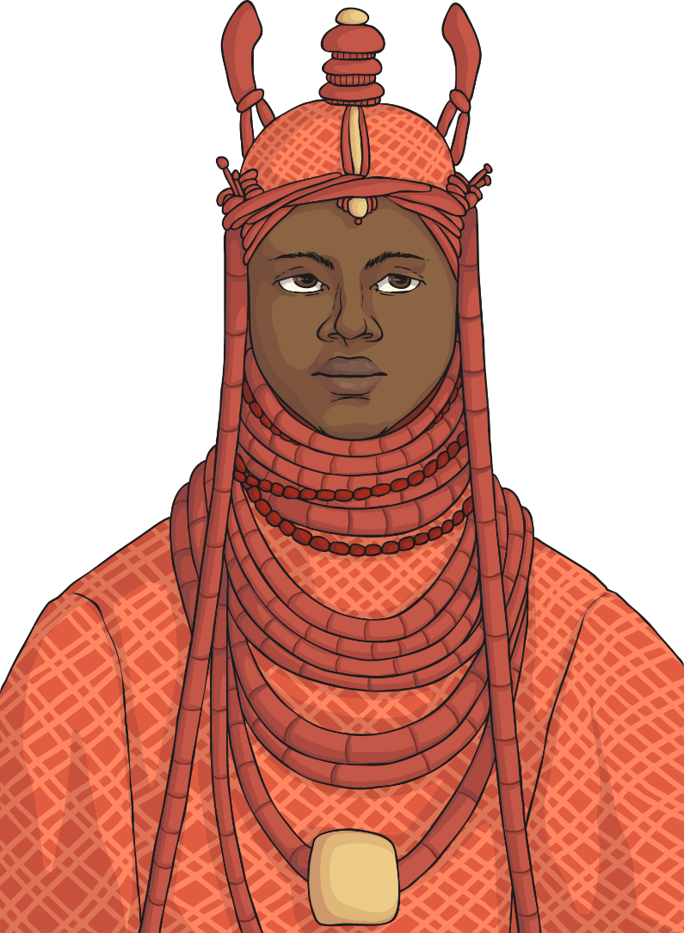
How Did the Kingdom of Benin Develop?
In AD 1180, Eweka became the new ruler of Igodomigodo and changed its name to Edo. He also called himself the Oba (the Yoruba word for king).
This marked the end of the Osigo Dynasty and the start of the Oba Dynasty began.

Slide 11
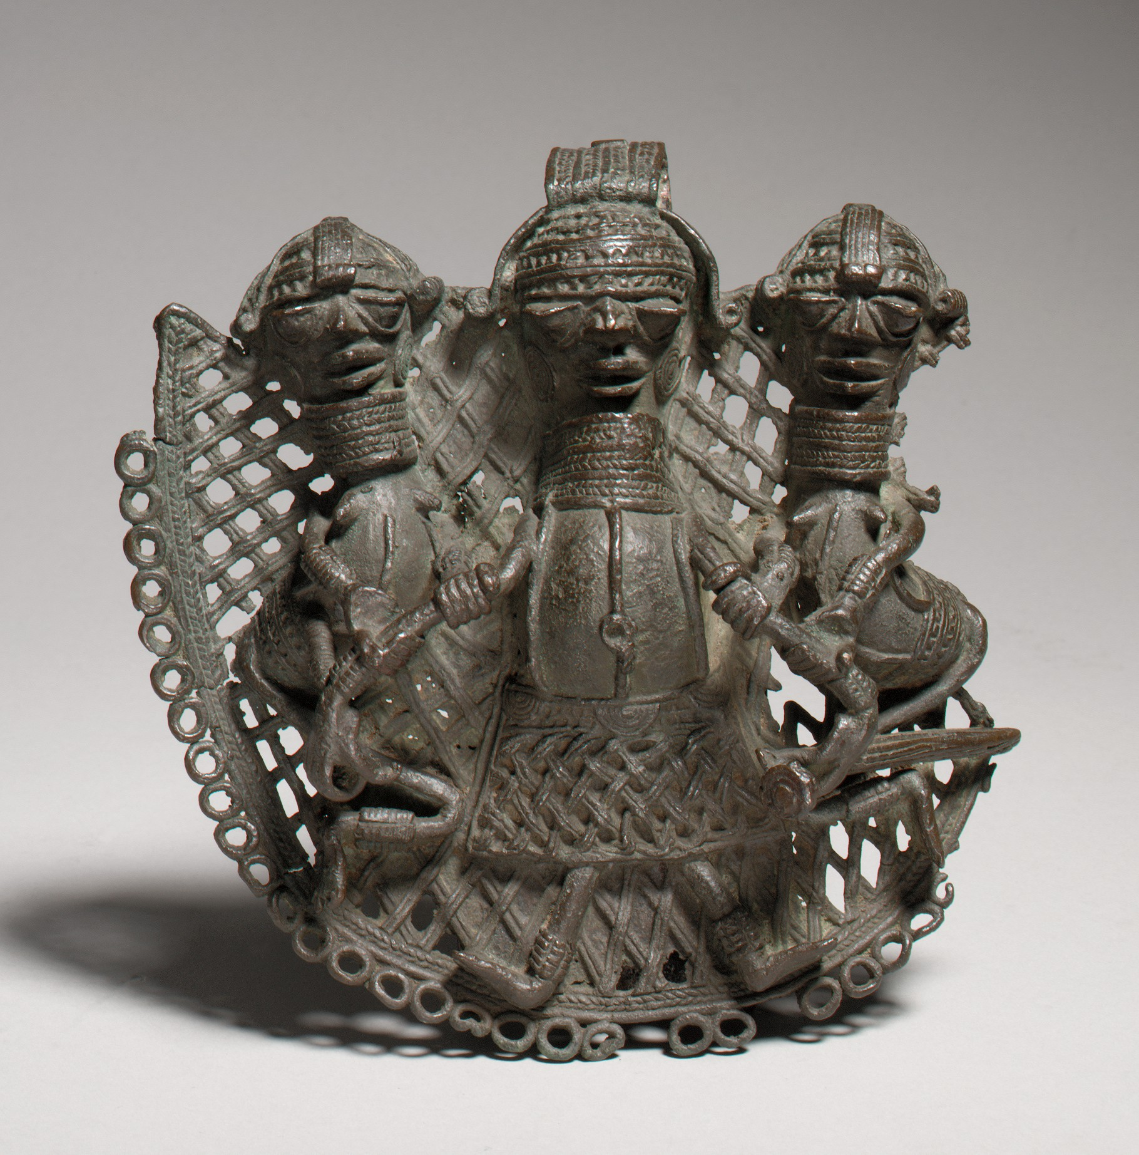
How Did the
Kingdom of Benin Develop?
AD 1300 - 1700 These years were considered to be a ‘golden age’ of Edo. It had a large powerful army and skilled craftsmen.

Slide 12
How Did the Kingdom of Benin Develop?
AD 1440 Oba Ewuare became Oba.
It is believed that from as early as AD 800, fortifications had started to be built around the city which later became known as Benin City.
Under Oba Ewuare’s rule, the city became even more fortified, with many moats and more walls being built around the city to protect it from invaders.
The walls were an incredibly well-planned and impressive human achievement. They were believed to be around 16,000km in length.
The Guinness Book of World Records (1974) described the Benin walls as being the second-largest structure built by humans after the Great Wall of China.
It is believed that the walls were completed in AD 1460.

Slide 13
How Did the Kingdom of Benin Develop?
Oba Ewuare and the Obas that followed on from him had strong armies and took over neighbouring areas, making the Kingdom of Benin much larger.

Slide 14
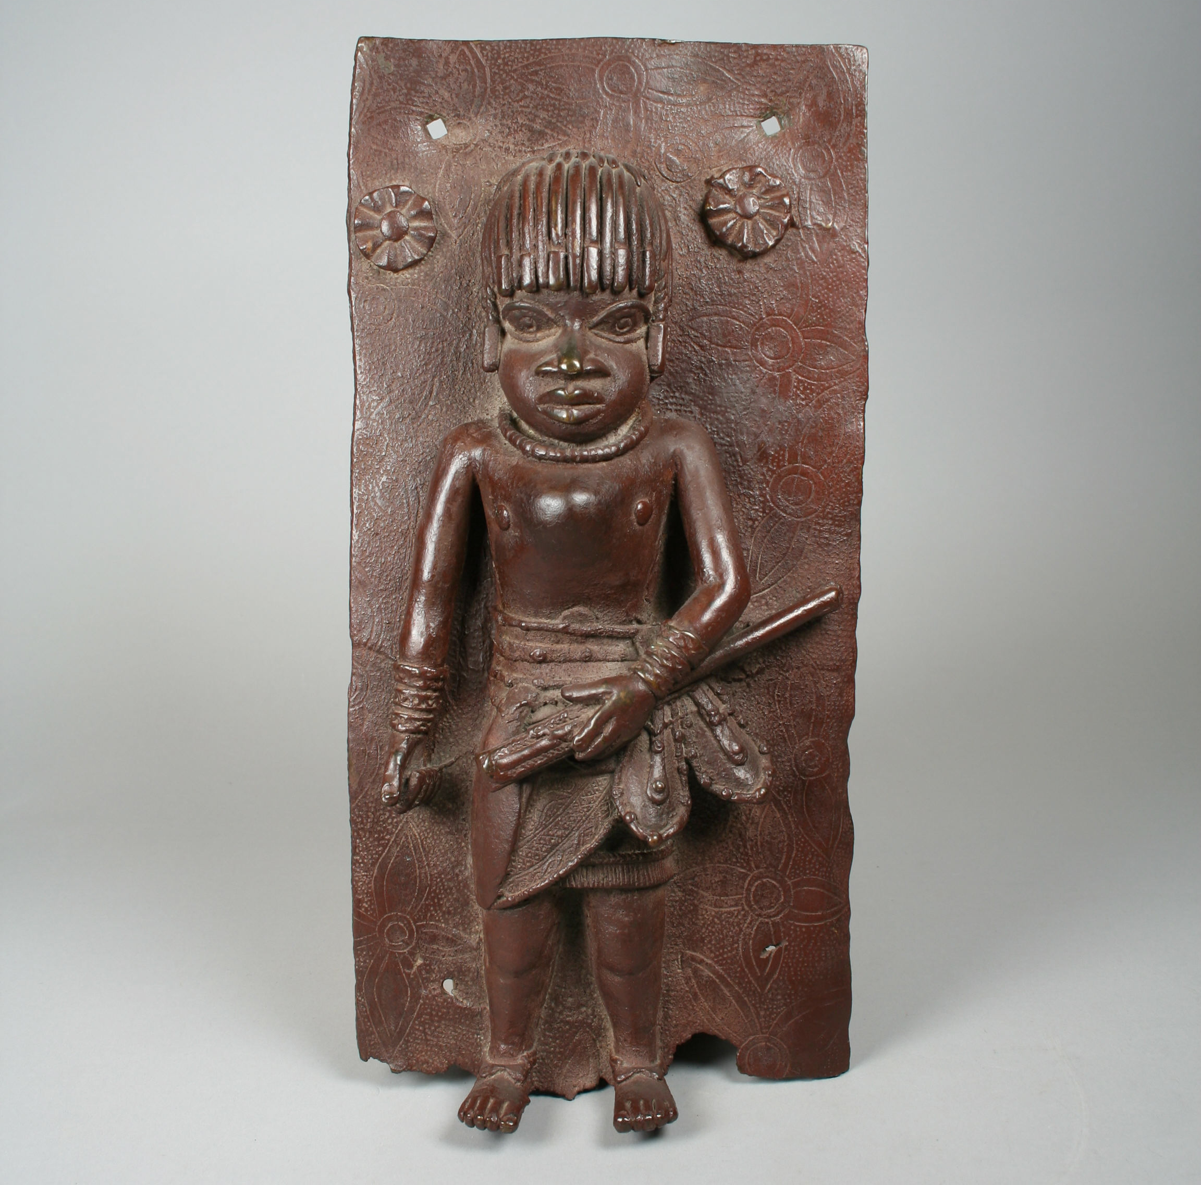
How Did the Benin
Kingdom Develop?
AD 1489 The Edo people began trading with the Portuguese. It was the Portuguese who called the place ‘Benin’.
Europeans arriving there were impressed by the well-planned City of Benin with its city walls, fine buildings and street lamps.

Slide 15
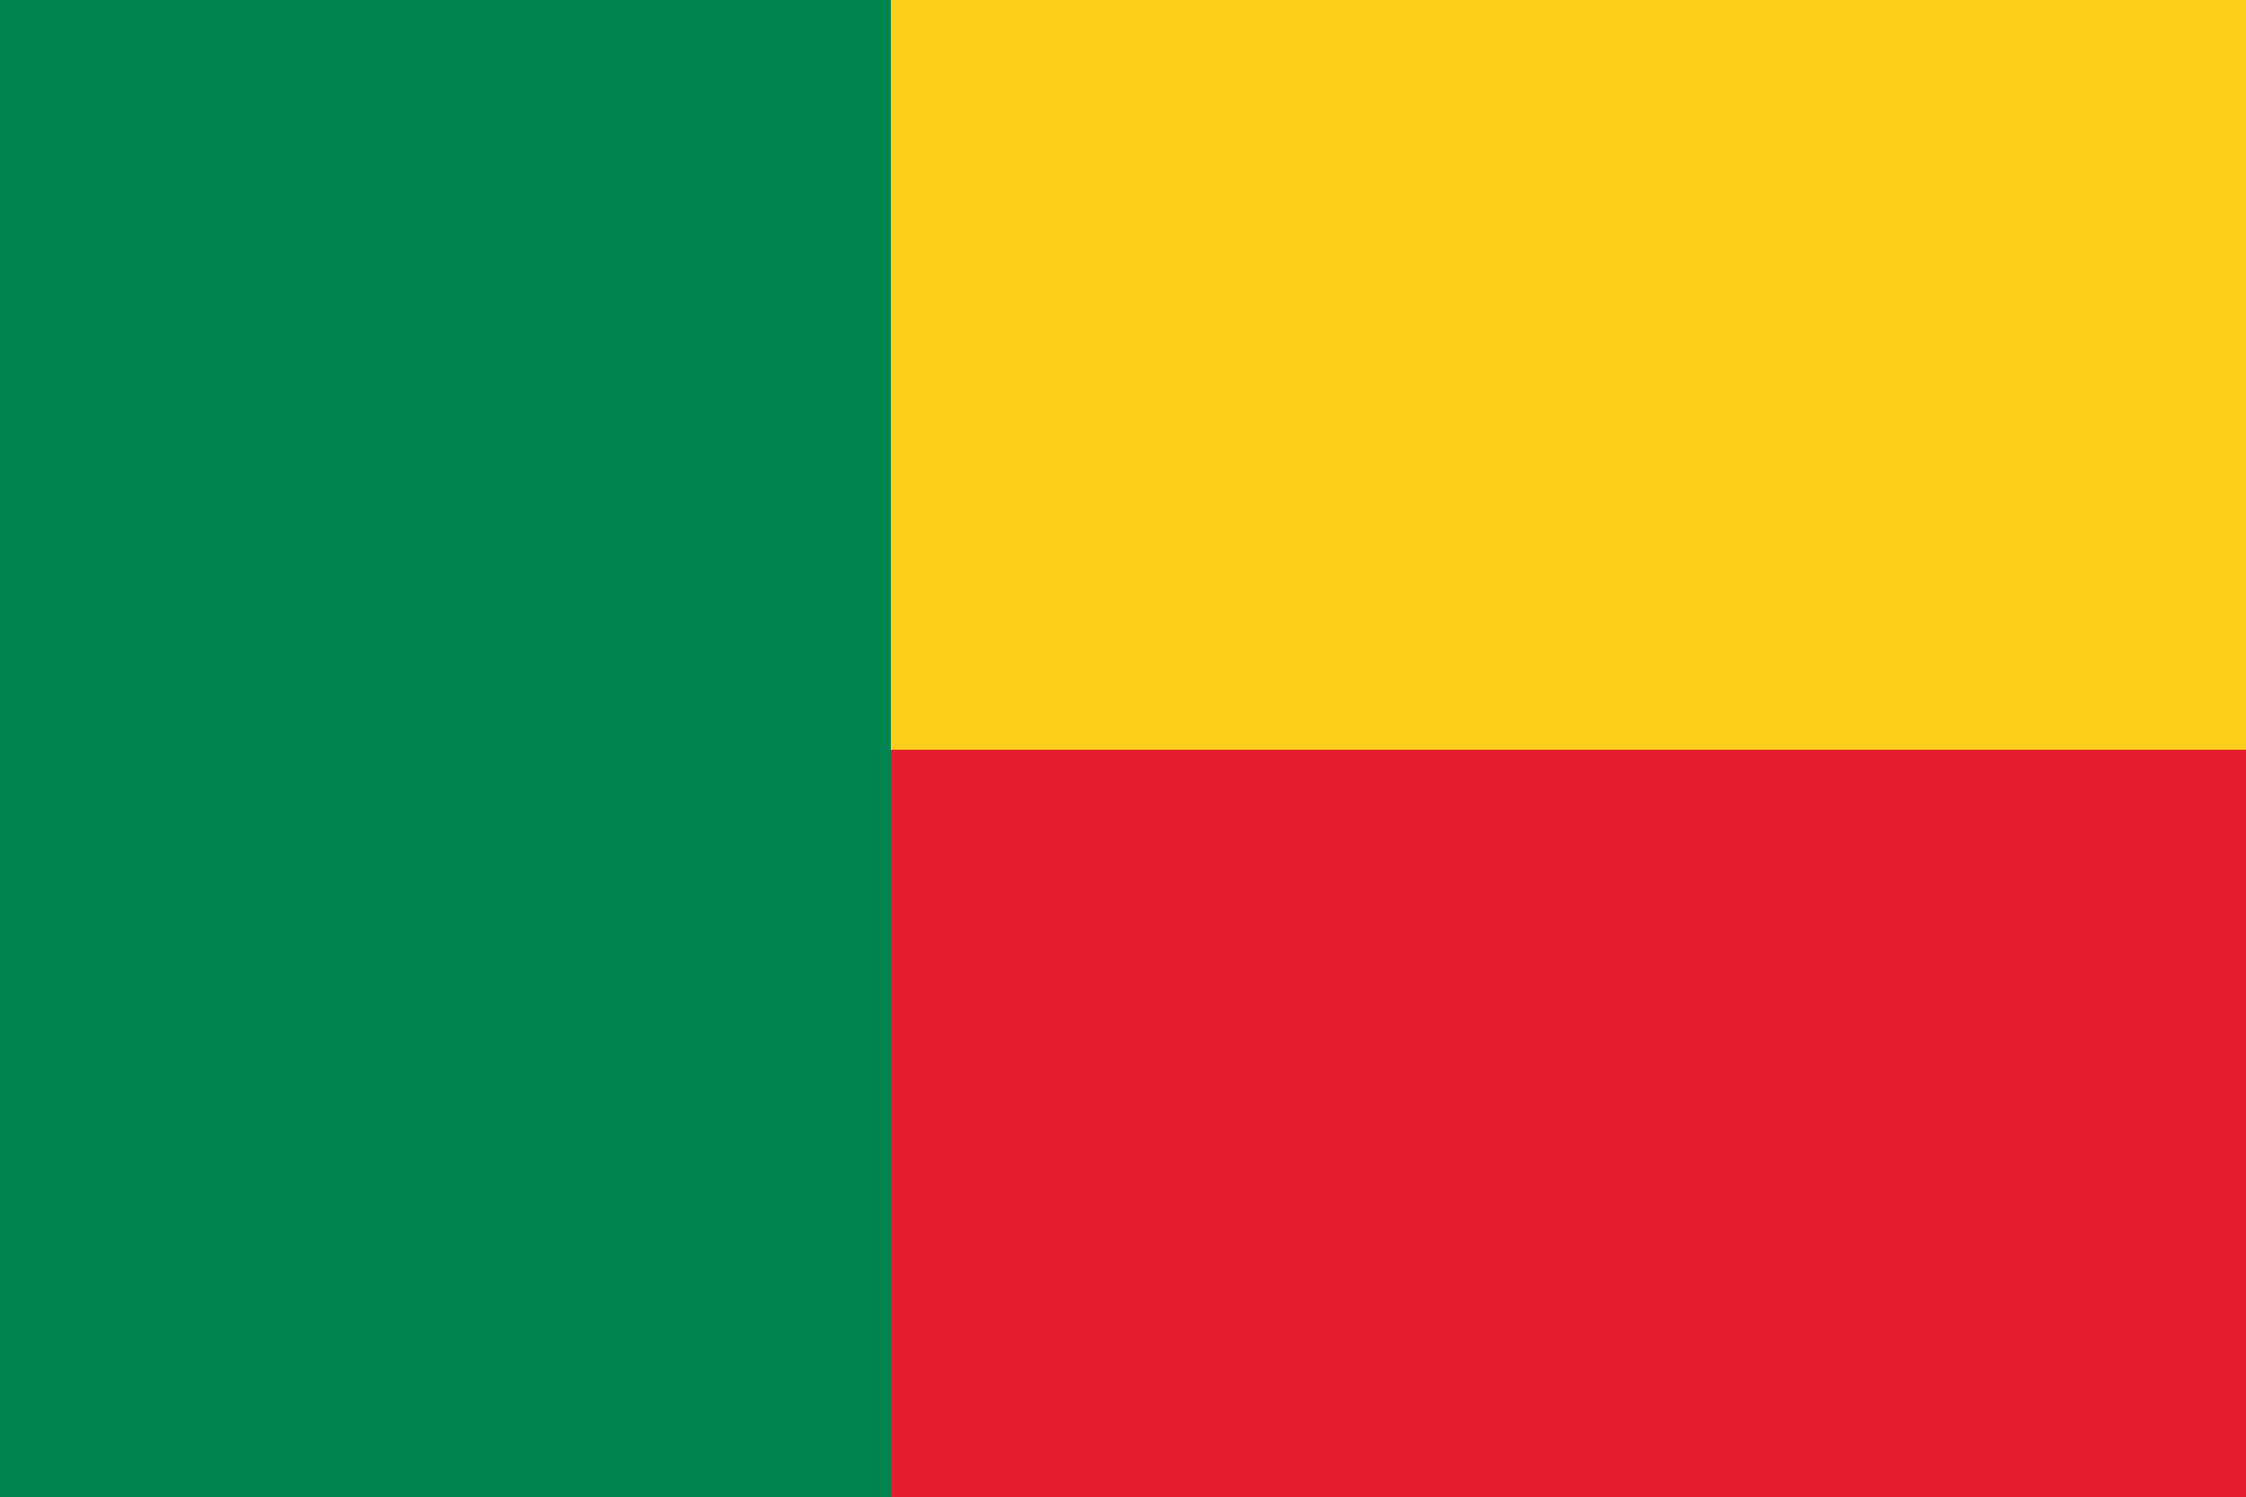
Benin Now
In 1897, Benin became part of the British Empire. In 1960, it became an independent country. There is still an Oba of Benin who leads religious ceremonies but is no longer a ruler of people.

